Slide 1
CSCI222 – Assignment 2 presentation
By Group B4

Slide 2
Group Members
Nguyen Duc Anh
William Wunady
Ardyanto
Wu Chin Hwa

Slide 3
Project Overview
This is a continuation of assignment 1.
Project overview, vision and mission remain largely the same to assignment with a few changes.
In addition to coding the program, we are also updating some of the things we have done in A1.
Some additional diagrams are also newly-created for this assignment.

Slide 4
Member Roles and Responsibility
No. | Member Name | Role | Artefacts
1 | Nguyen Duc Anh | Project Manager, Sub Designer | Use case diagram, Class diagram, Component diagram, SRS document, Project planning, Coding and Code testing
2 | William Wunady | Sub-manager, Project analyst | SRS document, Project planning and scheduling, All diagrams (part of), Presentation preparation
3 | Ardyanto | Project designer, Sub-analyst | Use case diagram, Activity diagram, Case analyzing, Sequence diagram, Code testing, Deployment diagram
4 | Wu Chin Hwa | Project analyst, Sub-designer, Documenter and Reviser | Use case diagram, Activity diagram, Risk analyzing, Sequence diagram, Deployment diagram, Project report

Slide 5
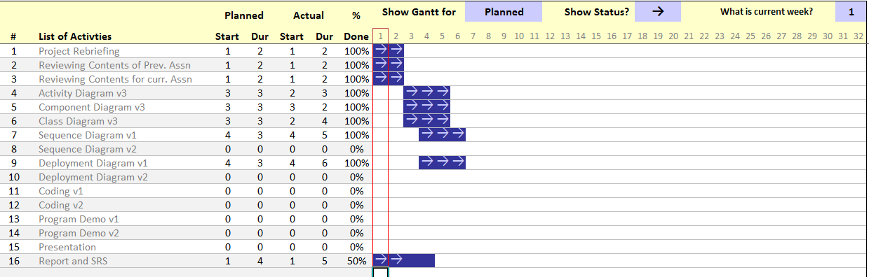
Project Planning
Phase 1:

Slide 6
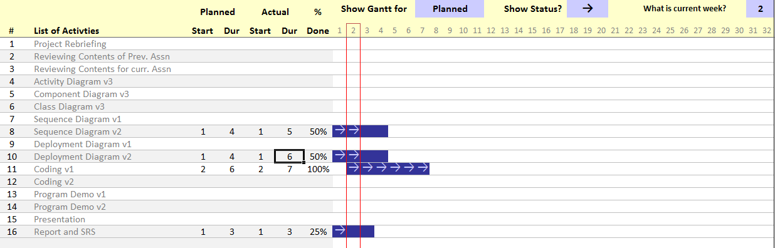
Project Planning
Phase 2:

Slide 7
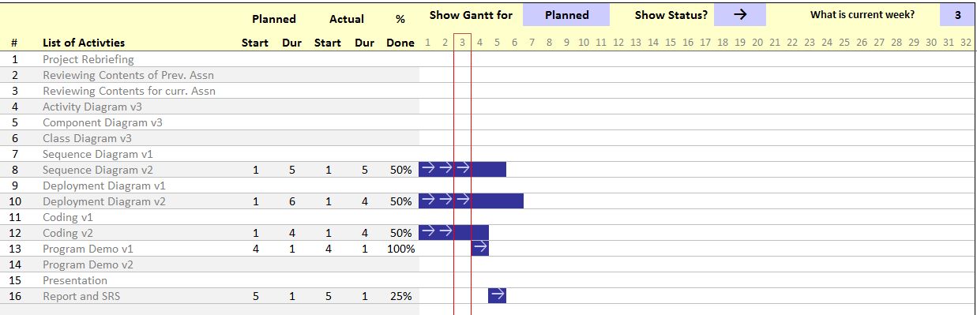
Project Planning
Phase 3:

Slide 8
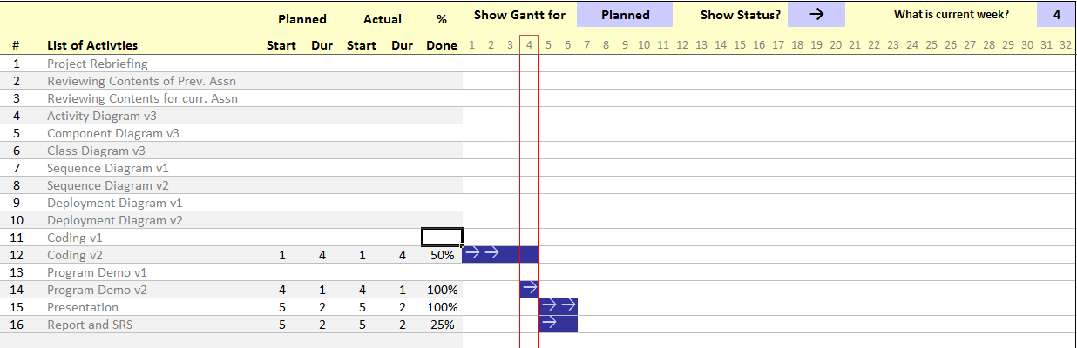
Project Planning
Phase 4:

Slide 9
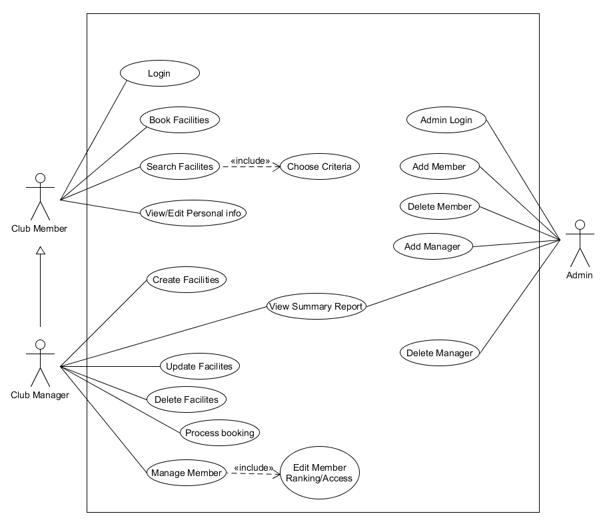
New Use Case Diagram

Slide 10
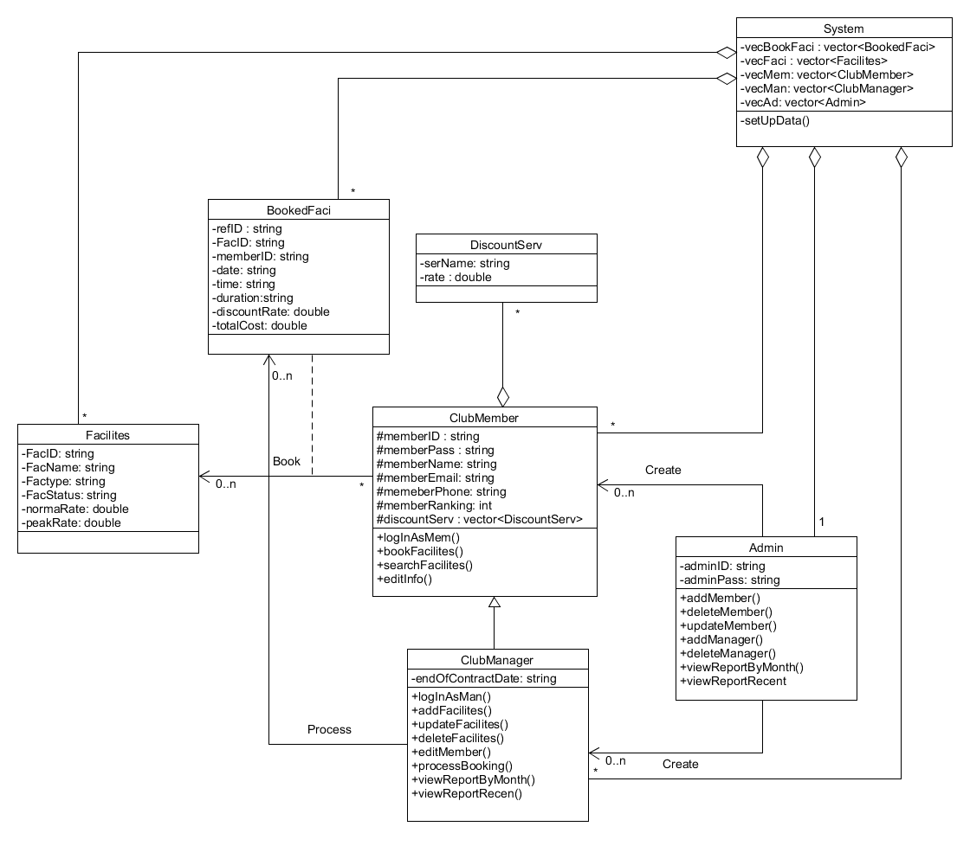
New Class Diagram

Slide 11
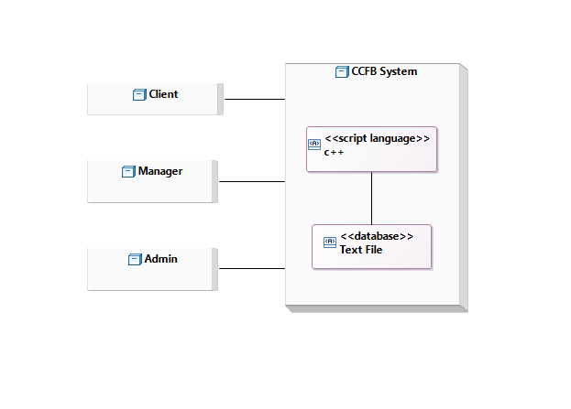
Deployment Diagram v1
Deployment Diagram is newly made for this assn.

Slide 12
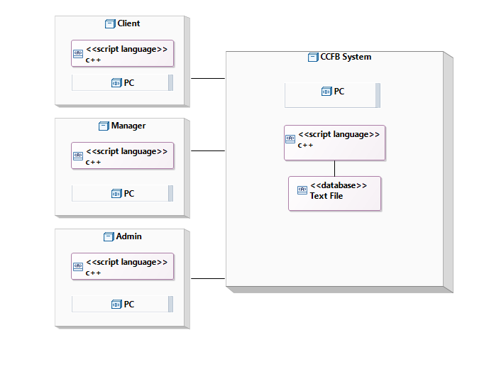
Deployment Diagram v2

Slide 13
Deployment Diagram Explanation
For our v1 deployment diagram…
We have 4 nodes which are:
Client, Manager, Admin, CCFBS (System)
Client, Manager, Admin will interact with System. All of them will use the artefacts inside the System, which is:
C++ Program and text files (database)
Four our v2 deployment diagram…
We added the program (same C++ program) and device used on each node to connect to the server (PC)

Slide 14
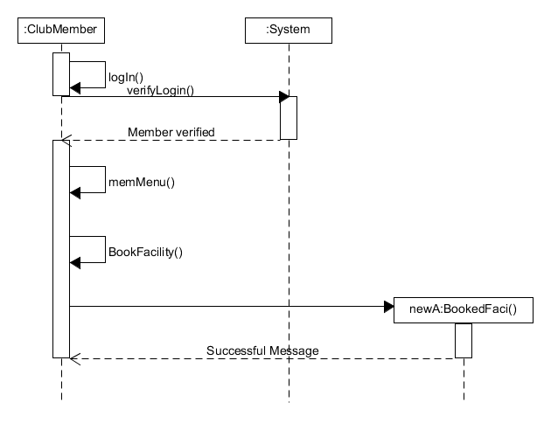
Sequence Diagram #1(Iter. 2)
Club member books a facility.

Slide 15
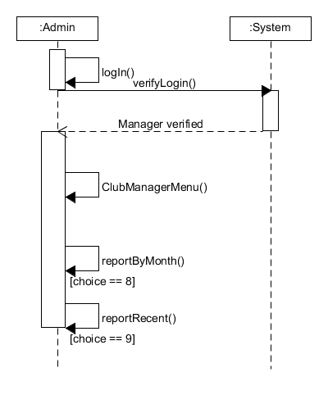
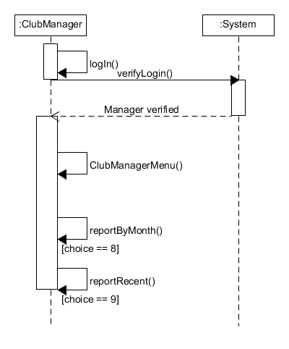
Sequence Diagram #2 (Iter. 2)
Admin/Manager wants to view booking reports.

Slide 16
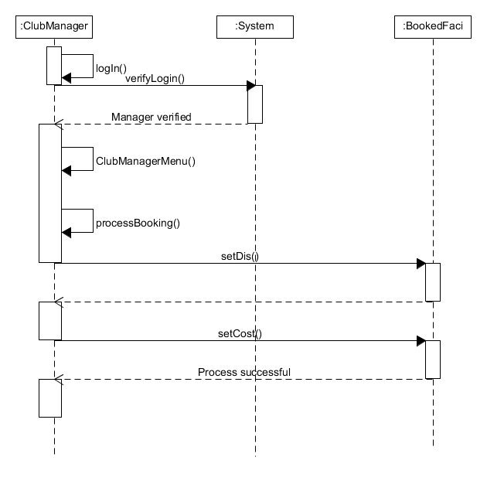
Sequence Diagram #3 (Iter. 2)
Club Manager processes a member’s booking.

Slide 17
Program Coding
This is a screenshot of CPPUnit test to verify the codes are working properly.

Slide 18
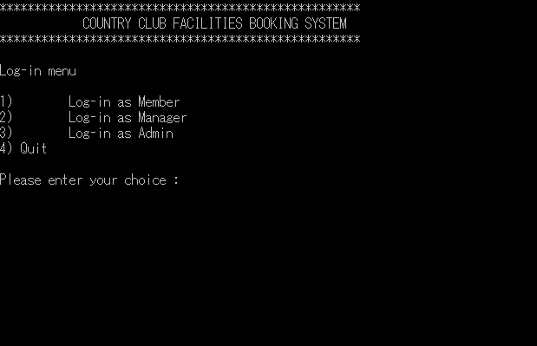
Program Use
This is a screenshot of the program’s main menu.

Slide 19
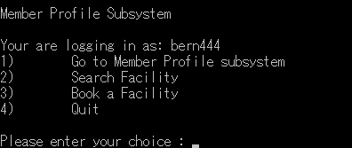
Program Use
This is a screenshot of a club member’s main menu.

Slide 20
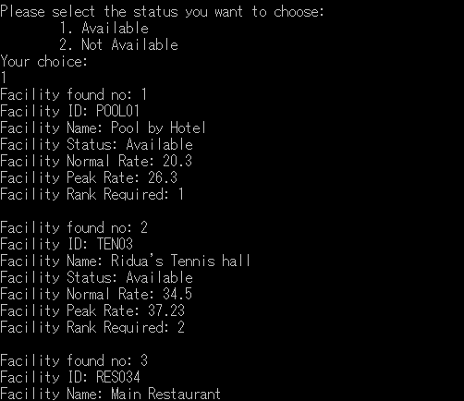
Program Use
Etc etc……..

Slide 21
Reports Included
Reports included are :
Detailed use case scenarios for each actor.
Project Risk Analysis and Management.
SVN Reports (Evidence of the usage of VCS).
Individual member work diaries.
Reports of all four group meetings.
Detailed Project overview and plans.
SRS (System Requirements Specifications).
Can see to each individual documents for details.

Slide 22
And that concludes our presentation.
We hope you enjoy watching through it.

